Slide 1
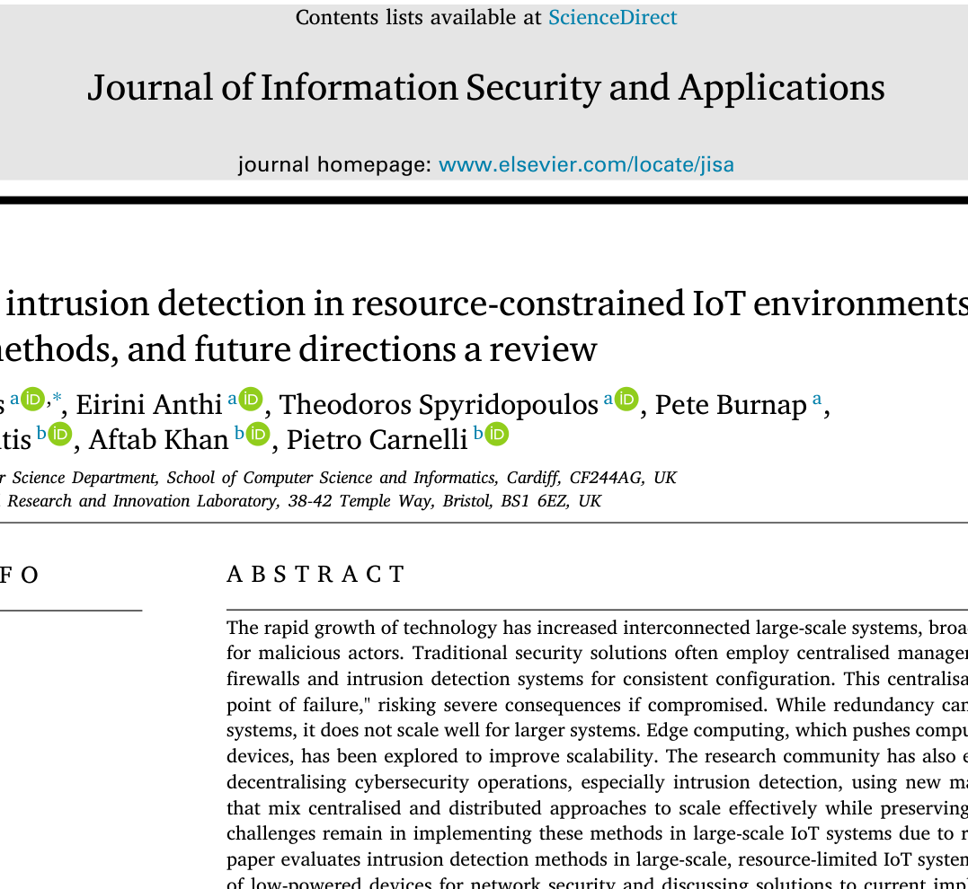
Tiny Smart Devices
Need Teamwork to Stay Safe
A class 4–5 friendly explanation of one research review paper
Paper topic: Collaborative intrusion detection in small IoT devices
One simple idea:
Devices can watch for bad behavior and learn together.
Based only on: Ieropoulos et al. (2025), Journal of Information Security and Applications
Notes:
Source: paper abstract lines 16-26; introduction lines 40-61. The paper is a review about collaborative intrusion detection for resource-constrained IoT environments.

Slide 2
1) What are tiny smart devices?
The paper calls many of them resource-constrained IoT devices.
IoT means small smart things connected to a network.
They can collect and share data.
💡
🔒
📷
🌡️
smart bulb
door lock
camera
sensor
They have small memory, small power, and often run on battery.
Examples named in the paper: Arduino, ESP8266 / ESP32, STM32, MSP430.
Easy example: like a small guard with a tiny backpack battery.
Based only on: Ieropoulos et al. (2025), Journal of Information Security and Applications
Notes:
Source: resource-constrained devices lines 185-203 and microcontroller examples lines 193-210.

Slide 3
2) What is called an attack?
In the paper, attacks are bad actions that try to disturb, control, or fool the devices.
Jamming attack
Blocks wireless messages with noise.
Battery attack
Makes the device do too much work until power drains.
Botnet attack
Weak devices are infected and controlled like “zombies.”
Adversarial attack
Tricks the AI by giving it confusing input.
📡
🔋
🧟
🎭
Think: attack = someone trying to make the smart device stop, obey them, or make a wrong decision.
Based only on: Ieropoulos et al. (2025), Journal of Information Security and Applications
Notes:
Source: attacks section lines 211-264, covering jamming, battery depletion, botnet, and adversarial attacks.

Slide 4
3) Where can the attack come from?
The paper says connected devices can be reached through communication protocols.
🕵️
📶
🏠💡🔒
🖥️
Network path
Wi‑Fi • Bluetooth
LoRa • Zigbee
Small IoT devices
weak passwords or unsecured messages
Bad actor
(threat actor)
Server / network
can be slowed or disturbed
Simple meaning: the attack travels through the same paths normal messages use.
Based only on: Ieropoulos et al. (2025), Journal of Information Security and Applications
Notes:
Source: introduction lines 40-52 mentions DoS, MITM, sniffing, hard-coded passwords, unsecured communication protocols, and Wi-Fi, Bluetooth, LoRa, Zigbee. Botnet DDoS description lines 246-253.

Slide 5
4) What does an IDS do?
IDS means Intrusion Detection System.
🛡️
An IDS is like a watchful guard.
It watches network traffic and device activity.
Examples named in paper:
SNORT, ZEEK, Suricata, Kismet, OSSEC
It looks for patterns.
It notices abnormal behavior.
It can warn about attacks.
For class 4–5: IDS = security guard for smart devices.
Based only on: Ieropoulos et al. (2025), Journal of Information Security and Applications
Notes:
Source: IDS section lines 266-283 and ML/anomaly matching lines 53-61.

Slide 6
5) What did the “code/framework” part do?
The paper is a review paper. It checks existing methods and frameworks.
The authors reviewed many studies about IoT security and collaborative learning.
They checked Federated Learning frameworks: TFF, FedLab, Flower, FATE, OpenFL, Syft, and others.
🔍
💻
🔐
They checked if the framework code really had:
• authentication = only trusted devices join
• encryption = messages/models are hidden
• IoT support = can work with smart devices
Important: the paper does not give one new program. It reviews and compares existing work.
Based only on: Ieropoulos et al. (2025), Journal of Information Security and Applications
Notes:
Source: contribution lines 125-139, FL frameworks lines 1317-1324, code-checking lines 1344-1347, Table 7 lines 1351-1368.

Slide 7
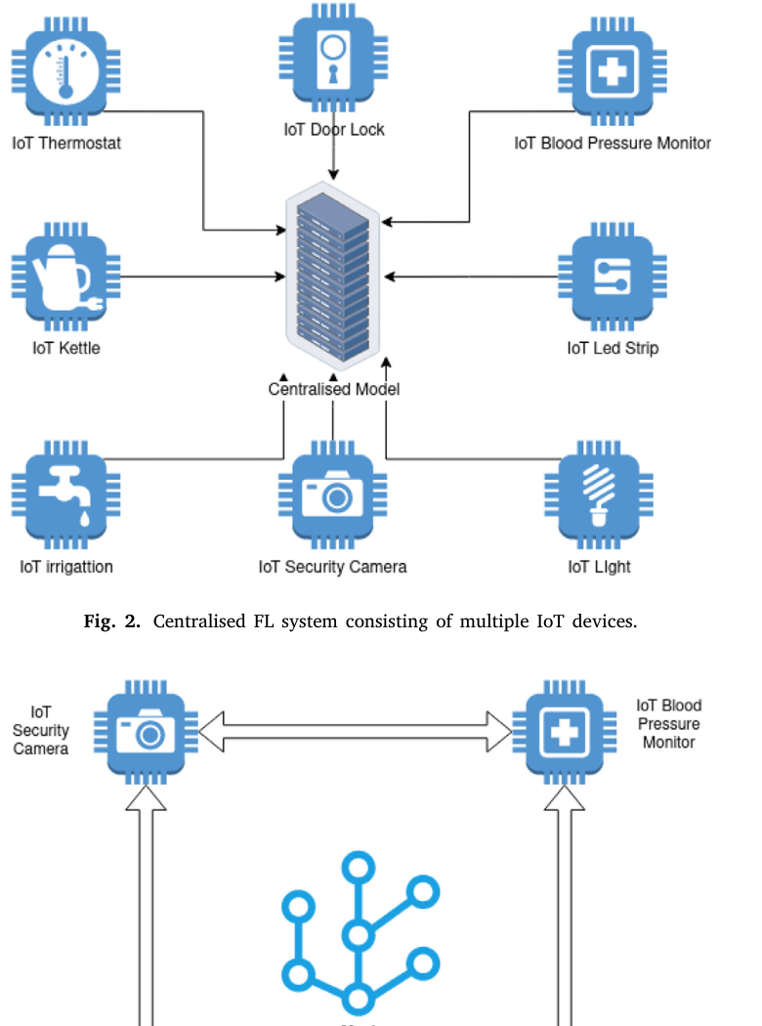
6) Main idea: devices learn together
Collaborative learning means many learners work toward the same goal.
Normal way: one big place may do the checking.
Problem: if that place fails, the system suffers.
Collaborative / Federated idea:
small devices learn from their own data and share learning, not raw private data.
Why helpful?
Better detection • less load on one device • privacy can be protected
Figure from the same paper: centralised and decentralised Federated Learning diagrams
Notes:
Source: collaborative learning lines 298-314; FL local training and not sharing sensitive data lines 89-98; Fig. 2/Fig. 3 captions lines 1251-1256.

Slide 8
7) The easiest summary
One minute explanation for a beginner.
Smart devices are useful, but they are small and weak.
Attackers can disturb messages, drain battery, control weak devices, or trick AI.
IDS watches for bad behavior.
The research says a good direction is teamwork: devices learn together and help detect attacks.
Takeaway: Tiny devices can be safer when they do not fight alone.
Based only on: Ieropoulos et al. (2025), Journal of Information Security and Applications
Notes:
Source: paper abstract lines 16-26, attacks lines 211-264, collaborative learning lines 298-314 and research gaps/future directions lines 1603-1661.

